Slide 1
Correlation Analysis HD Bikes Sales
Eyong

Slide 2
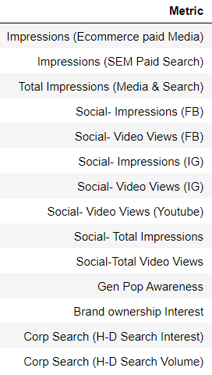
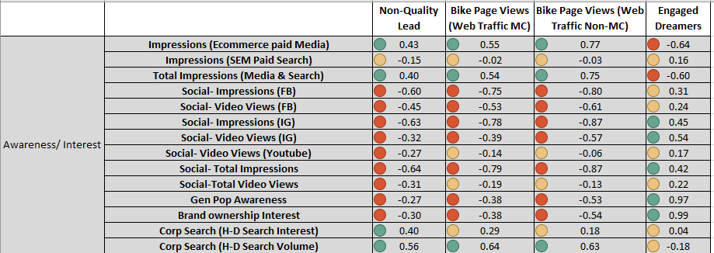
Awareness/ Intent to Consideration
Features we have used
Target Variables
Features Correlation
Awareness/ Intent features are having positive correlation with Consideration Variables
Analysis of each Target Variable (details on next page)

Slide 3
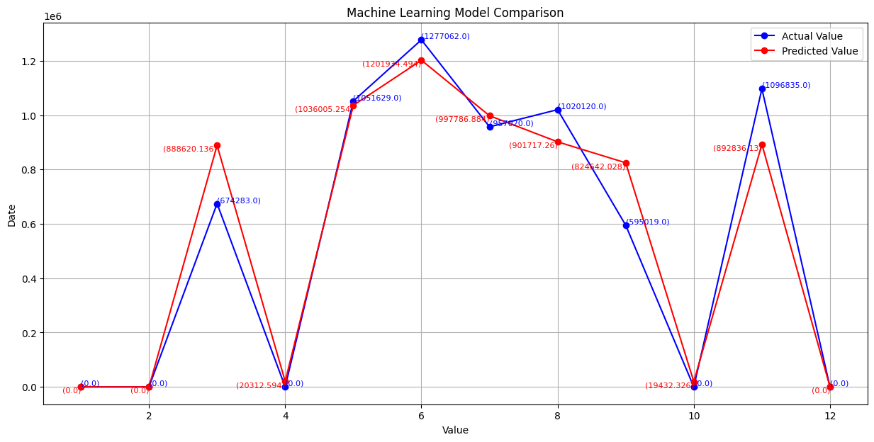
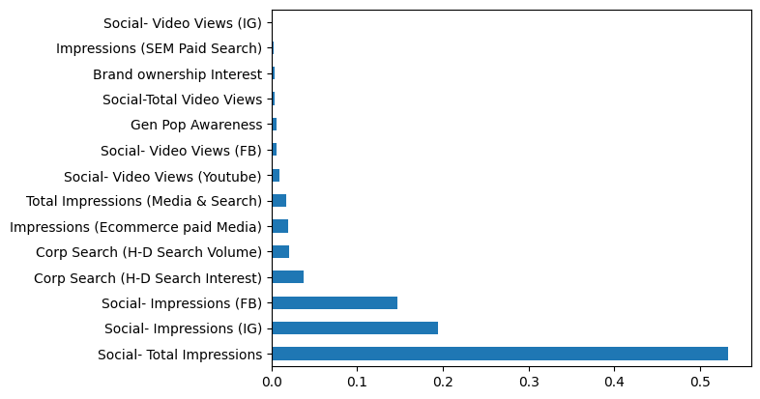
Awareness/ Intent to Consideration Bike Page Views (Web Traffic MC)
95% Accurate ML Model
Accuracy of the model shows that awareness/ interest features are good to predict Bike Page Views (Web Traffic MC)
Impressions and Corp Search are being the important variables to increase or decrease Bike Page Views
Brand Ownership Interest, Gen Pop Awareness, Social Media Videos views etc. have the potential to improve

Slide 4
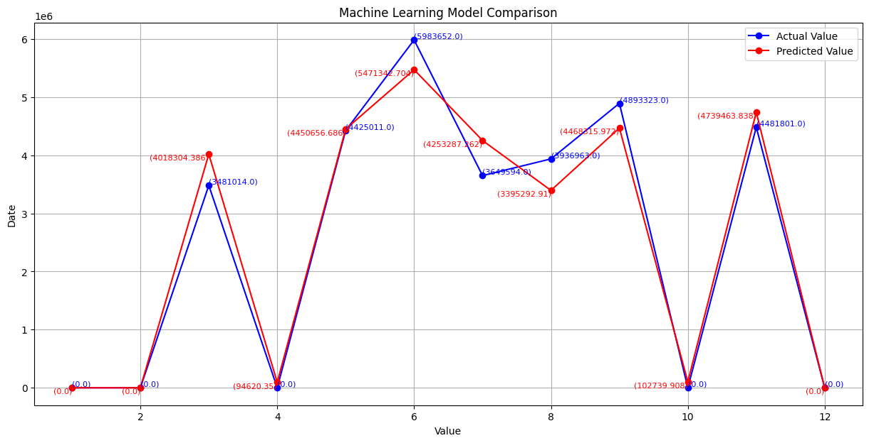
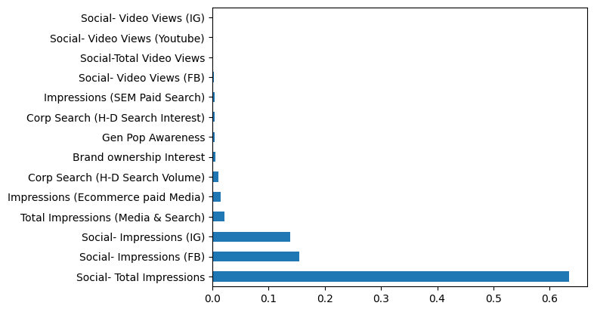
Awareness/ Intent to Consideration Bike Page Views (Web Traffic Non-MC)
98% Accurate ML Model
98% Accuracy of the model shows that awareness/ interest features are very good to predict Bike Page Views (Web Traffic Non-MC)
Social Impressions are being the most important variables to increase or decrease Bike Page Views for NonMC
All other variables have the potential to improve

Slide 5
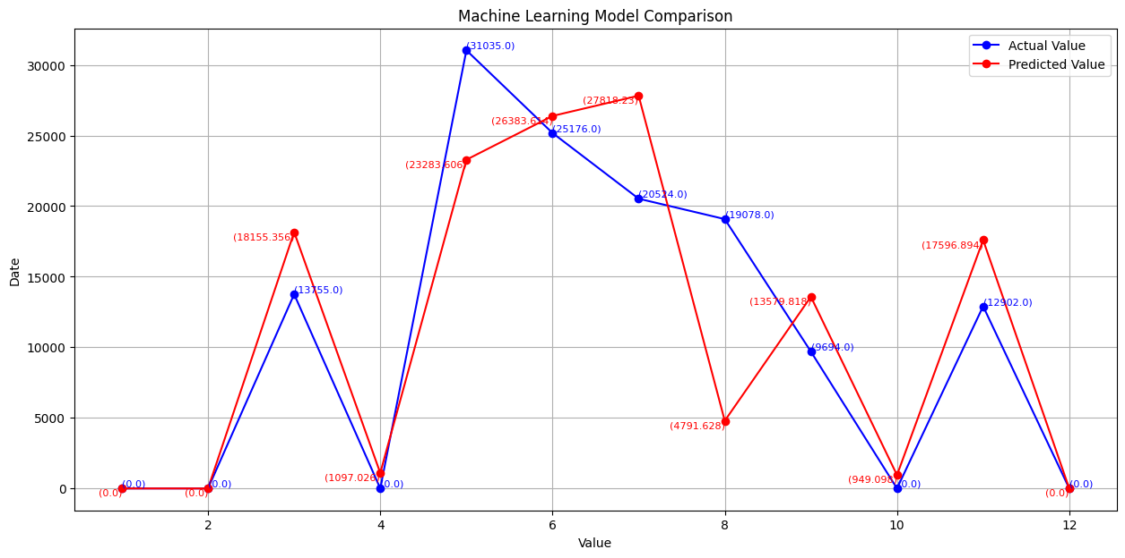
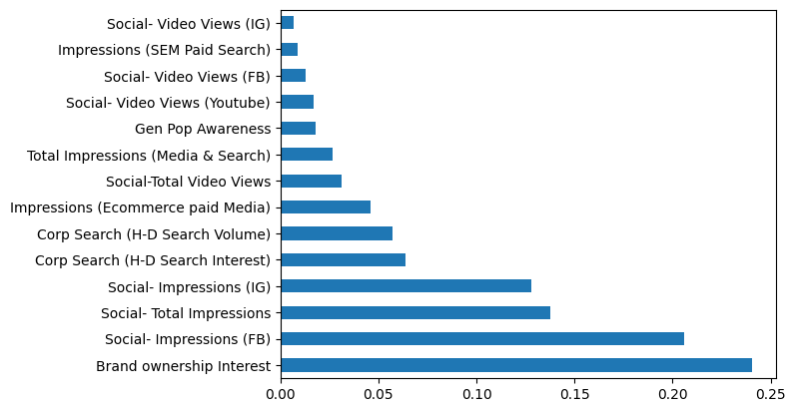
Awareness/ Intent to Consideration Non Quality Leads
73% Accurate ML Model
Accuracy of the model is almost good i.e. 73%, which shows that awareness/ interest features are effective to predict Non Quality Leads
Social Impressions, Brand Ownership Interest and HD Search are being the most important variables to increase or decrease Non Quality Leads
Variables related to VIEWS on VIDEOS on SOCIAL MEDIA have the potential to improve

Slide 6
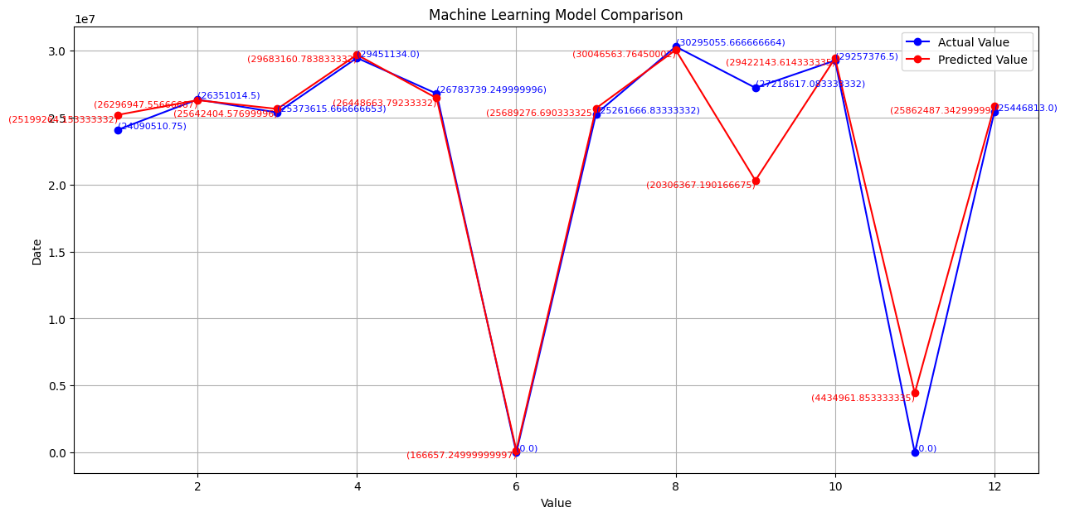
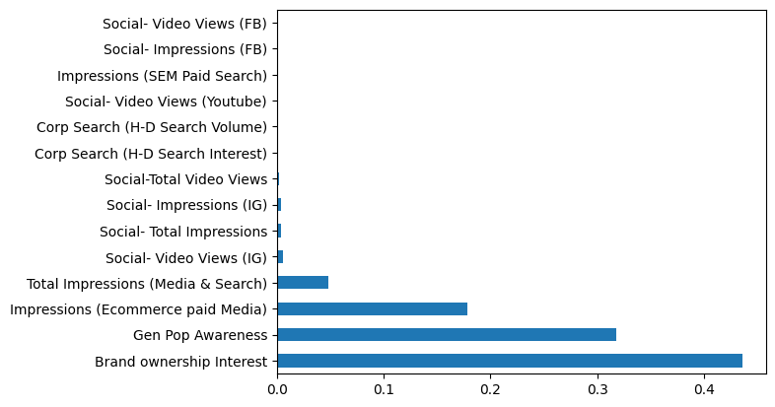
Awareness/ Intent to Consideration Engaged Dreamers
95% Accurate ML Model
Accuracy of the model is 95%, which shows that awareness/ interest features are effective to predict Engaged Dreamers
Ecommerce impression, Gen Pop Awareness and Brand Ownership Interest are being the most important variables to increase or decrease Non Quality Leads
Social Content Views/ Impressions needs to be revisit to improve the engaged dream values

Slide 7

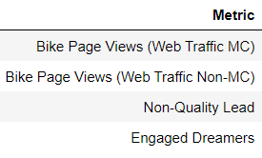
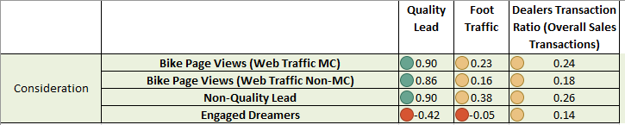
Consideration to Intent
Features we have used
Target Variables
Features Correlation
Consideration features (except engaged dreamers) have high positive correlation with Quality Lead Target Variable, while moderate positive correlation with Foot Traffic and Dealer Transaction Ratio
Analysis of each Target Variable (details on next page)

Slide 8
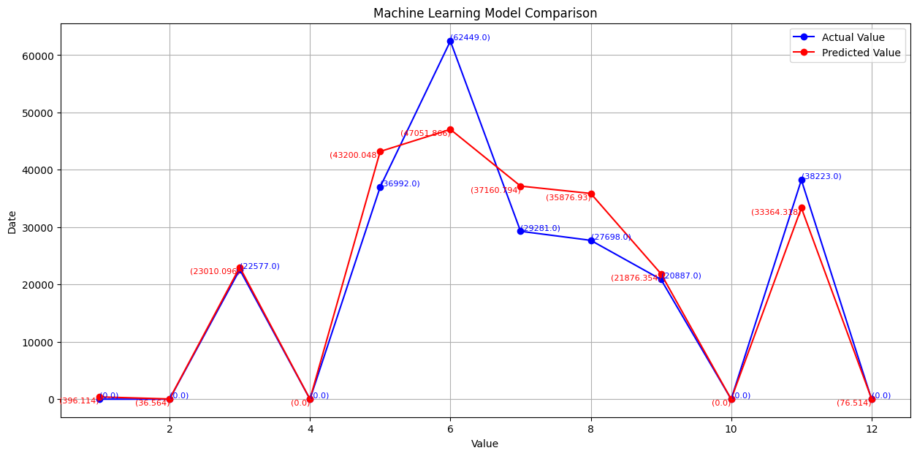
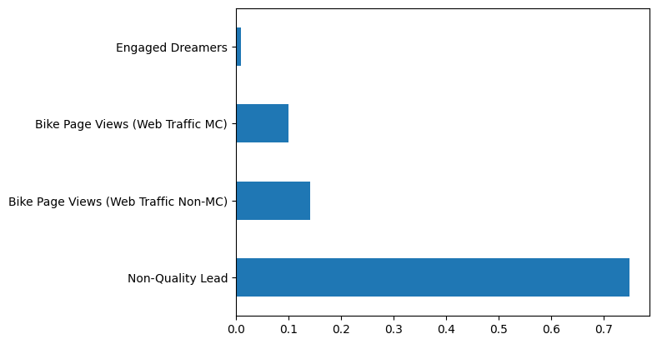
Consideration to Intent Quality Leads
91% Accurate ML Model
Accuracy of the model is 91% to predict Quality Leads on the basis of consideration features
Surprisingly Non Quality Leads and Non MC Page Views are important features
This shows the conversions intention is good if we have valuable Non Quality Lead Evaluation Mechanism and Optimized Non MC Page Views

Slide 9
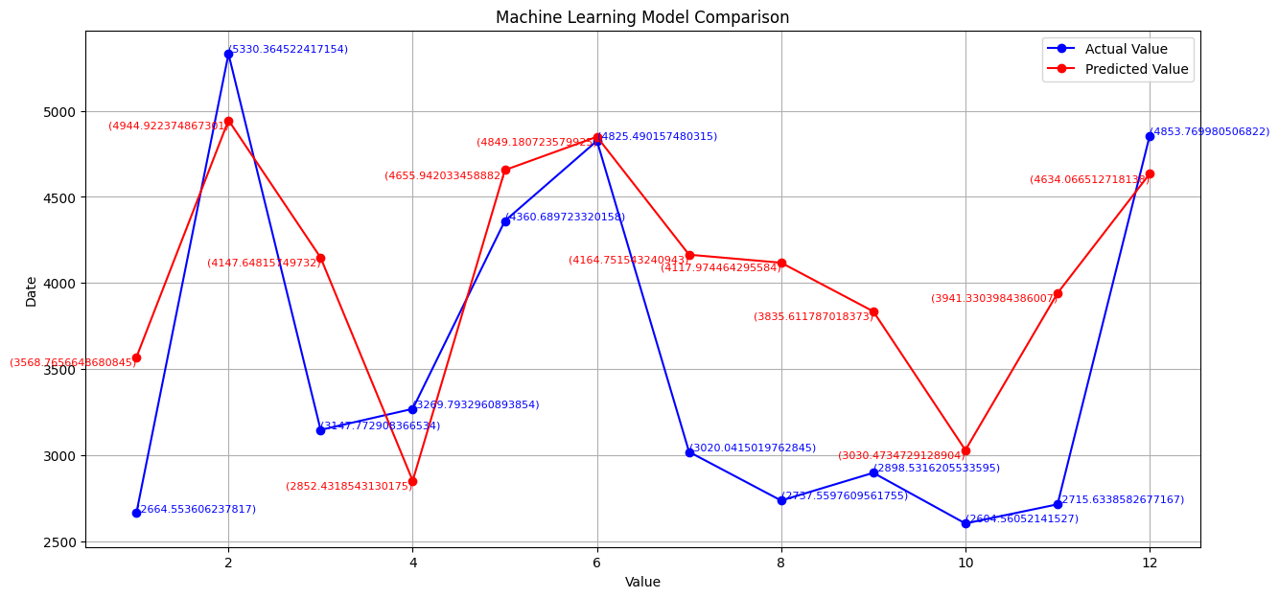
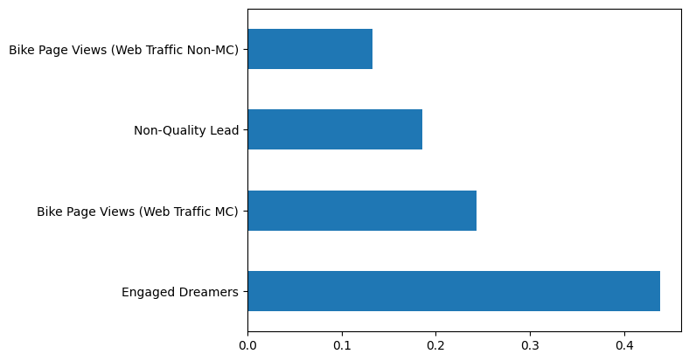
Consideration to Intent Foot Traffic
28% Accurate ML Model
Accuracy of the model is 28% (not very good), but still able to predict Foot Traffic on the basis of consideration features
Engaged Dreamers and MC Traffic are important features as compare to other
For best conversion, we need to optimize Non MC Page Views and Carefull evaluation of Non Quality Leads

Slide 10
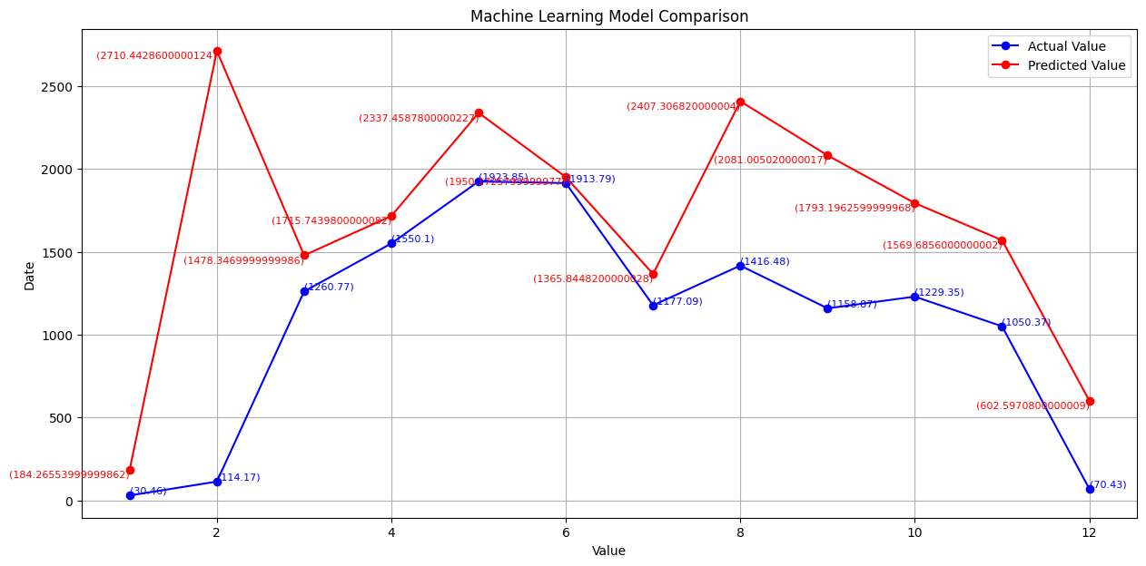
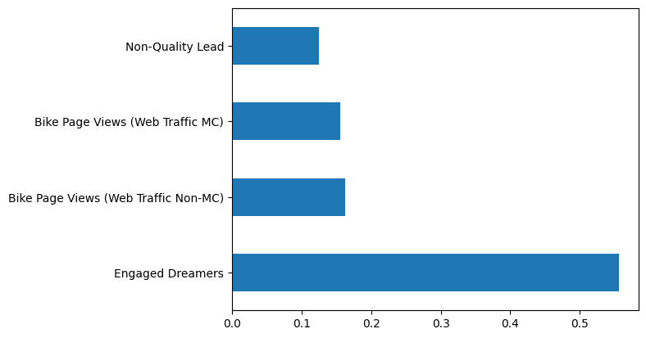
Consideration to Intent Dealers Transaction Ratio
Very Weak Model
Accuracy of the model is very weak in this case, it might be due to small amount of data we are using i.e. only 3 years data
Although features of Consider can be effective to predict Intent
For best conversion, we need to optimize Page Views and Carefull evaluation of Non Quality Leads

Slide 11
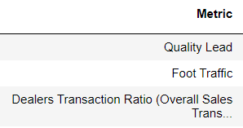

Intent to Conversion
Features we have used
Target Variables is Quality Lead Conversions (HD New Sales)
Features Correlation
Intent Variables have positive correlation with High Quality Lead Conversion
Quality Lead and Dealers Transactions Ratio have weak positive correlation
Foot Traffic has high positive correlation with target variable
Analysis of each Target Variable (details on next page)

Slide 12
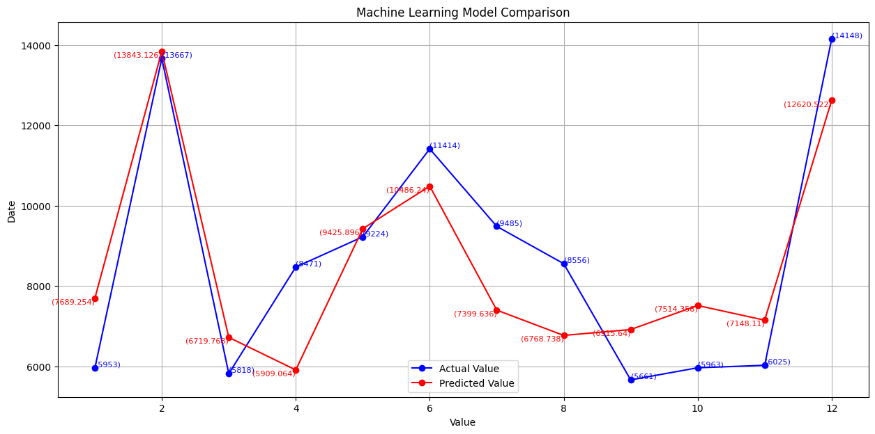
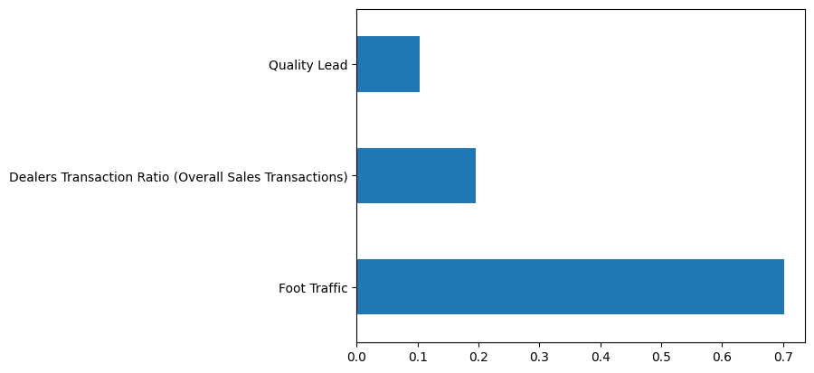
Intent to Conversion High Quality Lead Conversion
75% Accurate ML Model
Accuracy to predict Conversions is good enough i.e. 75%
Foot Traffic being the most important variable, then dealership transaction ratio and quality lead is lowest importance to predict Conversions
Quality leads should be carefully evaluated to increase conversions

Slide 13
Thanks
Any Question?

